Slide 1
Preparing your Organization for 2013:
"Are you ready for The DOL Audit"
AXIS RETIREMENT WEBINAR SERIES:
Listen to audio over your computer speakers or you may join by telephone:
Dial: +1 (470) 200-0304
Access Code: 838-805-305
We will begin at approximately 2:00pm EST
October 17, 2012

Slide 2
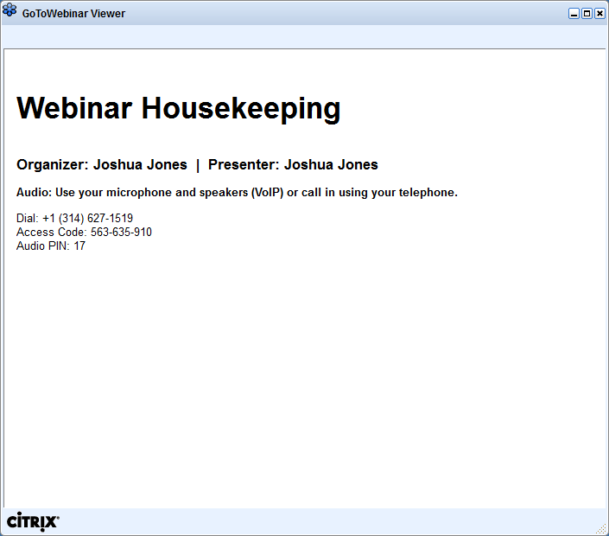

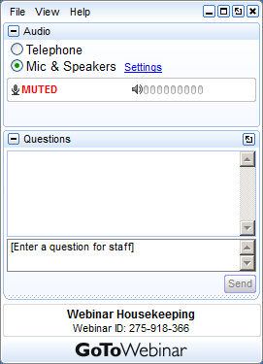
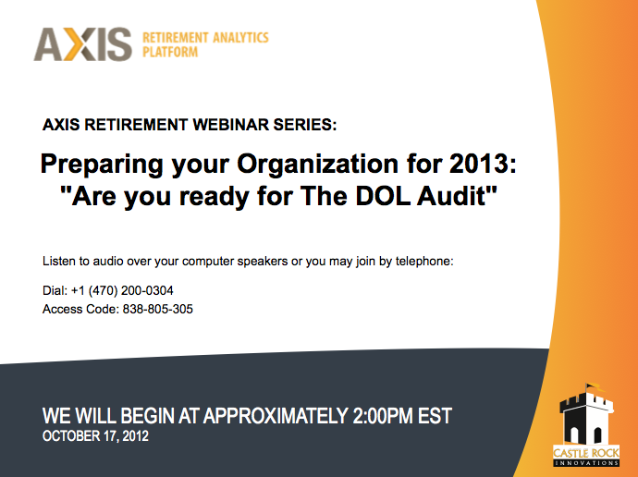

GoToWebinar Housekeeping
Notes:
Acquaint your Attendees with what they see on their screen.
To the left is the GoToWebinar Viewer through which you can see the presentation.
To the right is the GoToWebinar control panel where you can raise their hand, ask questions and select audio mode.
Note:
The attendee control panel will collapse automatically when not in use by an Attendee. To keep it open, Attendees can click the “View” menu and uncheck “Auto-hide Control Panel”.

Slide 3

Introduction to the Moderator
THOMAS LOCH
Senior Vice President, Castle Rock Innovations
BIO
25+ Year Retirement Services Career
Recordkeeping and Administration Technology
IRA Rollovers
Compliance
Advisor Servicing Applications
AXIS Retirement Analytic Platform
AXIS Retirement Plan Analytic Platform (AXIS) is web based software service that supports the ability for retirement plan fiduciaries to support DOL mandated section 408(b)(2), 404(a)(5) regulatory fee disclosure reporting requirements. We now support fee based benchmarking with a data repository of over 32,000 retirement plans.
tom.loch@castlellc.com
(973) 670-5087

Slide 4


Meet the Presenter
JOHN J. SOHN, Esq.
Partner, The Wagner Law Group
BIO
Legal expertise includes ERISA and fiduciary-related areas of securities law.
Extensive experience advising asset management firms, broker-dealers, banks, insurance companies and retirement platforms.
Over 17 years experience advising on retirement products and financial services.

Slide 5
AGENDA
Preparing your organization for 2013 -
“ARE YOU READY FOR THE DOL AUDIT”
2:00pm – 3:00pm EST
Industry Landscape
DOL Audit Preparation and Expectations
  Presentation from John Sohn, The Wagner Law Group
Q & A from Audience
Closing

Slide 6
The DOL 408(b)(2) / 404a-5 Regulations are Official
In February the dates were put in stone.
Many firms were caught off guard and were not prepared
Vendors scrambling to prepare finalized solutions
Lack of clear instructions and support from DOL
Regulation interpretations coming from prominent ERISA Attorneys, DOL bulletins and the “Rumor Mill”
Waves and waves of News Reports proclaiming the end is near!
Everyone is still waiting for the Participant Response
What is coming next from the DOL and how do we prepare?

Slide 7
Source of DOL Enforcement Authority
Civil Enforcement
ERISA 502(a) empowers DOL to bring civil actions.
ERISA 502(l) requires 20% civil penalty on all DOL settlements (subject to limited exceptions).
Criminal Enforcement
ERISA 501 imposes criminal sanctions for willful violations (maximum of $100k/$500k and 10 years).
Investigative authority
ERISA 504 grants DOL broad authority and may subpoena books/records.

Slide 8
EBSA’s National Enforcement Projects
Contributory plans criminal project (CPCP)
Targets employers and providers who commit fraud and abuse resulting in unpaid contributions to plans.
Rapid erisa action team (REACT)
Targets plans of employers filing for bankruptcy.
Employee stock ownership plans (ESOPs)
Consultant/adviser project (CAP)
Targets providers with undisclosed compensation and fiduciary self-dealing (variable compensation).

Slide 9
DOL Investigation Process
Reasons for initiating investigations
Participant complaints to Office of Participant Education
Referrals from other regulators (e.g., SEC, IRS)
Enforcement initiatives (National Enforcement Projects)
Form 5500 filings
Procedure for Dol investigation
Initial Letter (Document Request or Appointment Letter)
Document Production and On-Site Interviews
Closing Letter: (1) No DOL action to be taken, (2) “Voluntary Compliance” notice, or (3) Litigation letter

Slide 10
Best Practices
Before the audit
Maintain stand-alone ERISA policy.
Track all client accounts subject to ERISA.
Formalize procedure for 408(b)(2) notices and updates.
Maintain “model” client documents that reflect current law.
Ensure all client service agreements are signed.
Develop “model” response for routine 5500 info requests.

Slide 11
Best Practices
Before the audit (cont’d)
For fiduciary services, ensure compensation is level.
Confirm referrals (both ways) are fully disclosed and do not violate PT rules.
Confirm affiliated and third party subcontractors are fully disclosed and do not violate PT rules.
Provide ongoing education/training.
Internal audits.
Benchmarking.

Slide 12
Best Practices
During the audit
Choose one point person to serve as liaison.
Ask DOL for permission to bring in ERISA counsel.
Negotiate scope of document request (e.g., limit to sampling of client documents).
Perform legal review of subpoenaed and any other requested materials before delivery to DOL.
If any discrepancies are uncovered, provide explanation and/or proposed remedial action.
Prepare personnel for on-site interviews.

Slide 13


Slide 14
Q & A Discussion
Audience Participation Requested
Your Participation
Please submit your text questions and comments using the Questions Panel
Please raise your hand to be unmuted for verbal questions.
For more information, please contact tom.loch@castlellc.com
Note: Today’s presentation is being recorded and will be provided within 48 hours.
Notes:
Remind Attendees how to ask questions and provide “more info” or support contact.

Slide 15
In Closing
PREPARING YOUR ORGANIZATION FOR A DOL AUDIT
Be mindful of DOL’s national enforcement initiatives and broad investigative powers.
The recent roll-out of 408(b)(2) disclosures has further fueled DOL’s enforcement activities.
Firms should be pro-active in preparing for a potential future audit.
Remember the best practices for both before and during any DOL audit.

Slide 16
THANK YOU
VISIT AXISRETIREMENT.COM for more information on
408(b)(2) / 404(a)(5) COMPLIANCE AND INDUSTRY BENCHMARKING.
THOMAS LOCH
Sr. Vice President, Castle Rock Innovations
Tom.Loch@castlellc.com
(973) 670-5087
John Sohn, Esq.
Partner, The Wagner Law Group
johnsemail@
(555) 555-1212

