Slide 1


Slide 2


Target Date Funds and
Plan Sponsor Responsibilities
Live ByAllAccounts Webinar - May 16, 10AM EST
Presented by
Marcia S. Wagner, Esq.

Slide 3
About ByAllAccounts
ByAllAccounts is the only provider of intelligent data aggregation for financial services companies and the platforms on which their businesses depend.
We serve over 1500 clients, including Advisory firms, Wealth managers, Trusts and Asset managers.
We help clients:
Eliminate Manual Data Entry
Drive Back Office Efficiency
Access Hard-to-Get Account Data (retirement accounts)
Provide Holistic View of Client Portfolios
Save Time & Money

Slide 4
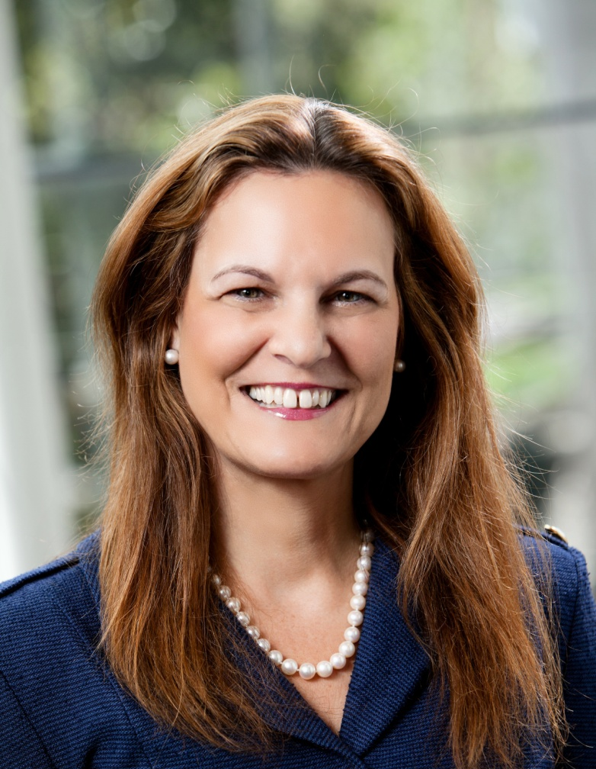
Marcia S. Wagner, Principal – Wagner Law
Principal of The Wagner Law Group, one of the nation’s largest boutique law firms, specializing in ERISA, employee benefits and executive compensation
Frequently quoted in The Wall Street Journal, Financial Times, Pension & Investments, many other industry publications
Provides counsel to advisors

Slide 5

Target Date Funds and
Plan Sponsor Responsibilities
Marcia S. Wagner, Esq.

Slide 6
Background on Target Date Funds
Popular default investment vehicle for 401(k) plans.
Typically, formed as open-end investment companies registered under the Inv. Co. Act.
Defining characteristic – “glide path” which determines the overall asset mix of the fund.
Performance issues in 2008 raise concerns, especially for near-term TDFs.
  Based on SEC analysis, the average loss for TDFs with a 2010 target date was -25%.
  Individual TDF losses as high as -41%.

Slide 7
TDF Developments Since 2009
DOL and SEC at Senate Special Committee on Aging hearing on TDFs (Oct. 28, 2009).
  Investor Bulletin jointly released by DOL and SEC.
  DOL’s fiduciary checklist on TDFs is pending.
SEC proposal for TDF advertising materials.
  If name has target date, “tag line” disclosure needed.
  Advertising must include glide path information.
On Nov. 30, 2010, DOL proposes rules on TDF disclosures for participants, amending:
  QDIA regs issued under PPA of 2006
  Participant-level fee disclosure regs that were finalized on Oct. 14, 2010 and became effective in 2012.

Slide 8
DOL Proposed Changes to QDIA Regs
Background on QDIA Regs
  Participant deemed to be directing investment to default choice if QDIA requirements are met.
  Default investment must be a QDIA, and QDIA notices must be provided to participants.
DOL proposes change to QDIA notice for TDFs.
  Explanation and illustration of TDF’s glide path.
  Relevance of target date (e.g., 2030) in TDF name.
  Disclaimer that TDF may lose money after retirement.
DOL also proposes general changes to QDIA notice (even if not a TDF).

Slide 9
DOL Proposed Changes to
Participant-Level Disclosure Regs
Background (recap)
  New rules will require disclosure of plan-related fees and annual comparative chart for plan’s investments.
DOL proposes change to annual comparative chart for TDFs (even if not a QDIA).
  Must include appendix with additional TDF info.
  Same info as required for QDIA notice.
Informal follow-up guidance from DOL
  TDF prospectus is unlikely to satisfy QDIA notice and annual comparative chart requirements, as proposed.
  DOL will not provide “model” target date disclosures.

Slide 10
TDF Conflicts of Interest
Conflicts arise when a “fund of funds” invests in affiliated underlying funds.
  Conflicts are permitted because fund managers are carved out from ERISA’s fiduciary requirements.
Are fund managers ever subject to ERISA?
  Firm requested clarification on scope of carve-out.
  In Adv. Op. 2009-04A (Avatar Associates), DOL declined to rule that the TDF managers are fiduciaries.
Implications of DOL guidance
  Plan sponsors are alone in their fiduciary obligation.
  Must ensure TDFs (and underlying funds) are appropriate plan investments.

Slide 11
Fiduciary Status of TDF Managers
TDF assets not considered plan assets subject to ERISA fiduciary standards.
TDF investment advisers not treated as ERISA fiduciaries
  Confirmed by DOL Advisory Opinion 2009-04A.
DOL view: plan sponsor alone has duty to evaluate and monitor TDFs

Slide 12
Congressional Proposals for TDFs
Former Senator Kohl announced his intent to introduce new legislation (Dec. 2009).
  Concerns over high fees, low performance or excessive risk in many TDFs.
  Would impose ERISA fiduciary status on TDF managers when TDF used as QDIA in 401(k) plans.

Slide 13
DOL Tips for Selecting a TDF
Objective process required to obtain information on prospective TDF investment.
Start process by examining TDF prospectus.
Question TDF providers on how TDF features match plan objectives and demographics.
  Investment Performance
  Fees & expenses
  Glidepath
  Landing point
Periodically check for changes in TDF characteristics.
  Management team
  Investment strategy

Slide 14
DOL Tips Regarding TDF Investments, Fees & Expenses
Check when TDF reaches most conservative investment allocation.
  To retirement
  Through retirement
Determine if TDF Fees are justified by performance and services.
  Overall fee
  Fees of underlying funds
  Ensure excess of overall expense ratio over underlying fund expense ratios is justified by extra service, access to special investments, etc.

Slide 15
DOL Tips: Employee Communications, Customized Funds & Consultants
Provide participants meaningful TDF disclosures.
  General information about TDFs (e.g., nature of glidepath)
  Specific information regarding prospective TDF investment (e.g., performance, fees & expenses)
  Provide actual glidepath illustration
Explore use of customized TDFs where underlying assets are existing plan investment options.
Seek advice of consultants/experts, if needed.
  Review & evaluate consultant recommendations
  Do not rubberstamp

Slide 16
Target Date Funds and
Plan Sponsor Responsibilities
Marcia S. Wagner, Esq.
99 Summer Street, 13th Floor
Boston, MA 02110
Tel: (617) 357-5200 Fax: (617) 357-5250
Website: www.wagnerlawgroup.com
marcia@wagnerlawgroup.com
A0096171

Slide 17

Q&A
Thank you!
CONTACT
ByAllAccounts for 10-minute complimentary phone consultation:
Jhan Frias
ByAllAccounts
Office: (781) 376-0801 ext. 129
Mobile: (401) 780-7119
JFrias@byallaccounts.com

