Slide 1


Slide 2
Longevity Planning in
Retirement Plans
March 23, 2014
2

Slide 3
George Revoir
John Hancock Retirement Plan Services
Marcia S. Wagner
The Wagner Law Group
Chuck Williams
Sheridan Road Financial
Moderator
Joan M. Neri
Drinker Biddle & Reath
3

Slide 4
Overview and Legal Considerations
  Lifetime Income Solutions for DC Plans
  Fiduciary Standards
  DOL Proposal
4

Slide 5
Lifetime Income Solutions and DC Plans
  Three Basic Approaches
    External Solution (Outside of Plan)
    Distribution Option Within Plan
    Investment Vehicle Within Plan
  External Solution
    Participants purchase IRA Annuities.
    Annuitization occurs outside of plan through rollovers.
    Internet portals can improve participant access.
5

Slide 6
“In Plan” Lifetime Income Solutions
  Distribution Option Within Plan
    Plan purchases Distribution Annuities.
    Immediate annuity purchased at time of distribution.
    Annuity contract is distributed to participant.
  Investment Vehicle Within Plan
    Plan invests in Group Annuity.
    Offers various investment and distribution options.
    Participant’s account converted to lifetime income.
6

Slide 7
Comparison of Retirement Income Strategies
    Guaranteed Access to Cash
    Income? In Retirement?
  Systematic Withdrawals No Yes
  Managed Payout No Yes
  Distribution Annuities Yes No
  Group Annuity (Traditional) Yes No
  Longevity Insurance Partial Partial
  GLWB (Group Annuity) Yes Yes
7

Slide 8
Guaranteed Living Withdrawal Benefit (GLWB)
  Guaranteed Withdrawal
    Guaranteed percentage of “Benefit Base” may be withdrawn annually during retirement years.
    Guarantee takes effect when account’s investment value is insufficient to cover guaranteed withdrawals.
  Benefit Base
    Initial value is based on contributions.
    Future value may “roll up” by fixed percentage each year, or “step up” based on anniversary value of account.
8

Slide 9
Need for Additional Fiduciary Guidance
  Selection of Annuity Provider and Annuities
    Subject to ERISA fiduciary standards.
    Must act in accordance with duty of prudence and loyalty.
  Existing DOL Guidance
    1995 guidance on Distribution Annuities for DB plans.
    2008 safe harbor on Distribution Annuities for DC plans.
    No clear guidance on other annuities for DC plans.
9

Slide 10
Current Fiduciary Standard for Annuities
  DC Plans and Lifetime Income
    Lack of clear guidance has not stopped DC plan sponsors
    (e.g., United Technologies adds GLWB annuity option).
  DOL’s 2008 Safe Harbor
    Provides useful framework for plan fiduciaries in general.
      1) Procedural Prudence 2) Insurer’s Payment Ability
      3) Cost 4) Conclusions
      5) Seeking Expert Advice
10

Slide 11
1st Step (Procedural Prudence)
  Engaging in Objective, Analytical Process
    Prudence of fiduciary act is based on process.
    Must conduct appropriate investigation of annuity investment.
  Documentation of Selection Process
    Maintain minutes of fiduciary reviews.
    Records for ongoing monitoring.
11

Slide 12
2nd Step (Insurer’s Payment Ability)
  Obtaining Sufficient Information
    Insurer’s experience and expertise
    Level of capital
    Ratings
    Contract’s structure and benefit guarantees
    Protection through state guaranty associations
  DOL Proposal
    Proposed amendment to DOL safe harbor (Oct. 2014)
12

Slide 13
3rd Step (Cost) and 4th Step (Conclusions)
  Considering Annuity’s Cost
    Cost considered in relation to benefits and services.
    Evaluate fees, commissions and other charges.
    No requirement to select cheapest annuity.
  Drawing Informed Conclusions
    Conclude insurer will be able to make future payments.
    Conclude annuity’s cost is reasonable.
13

Slide 14
5th Step (Seeking Expert Advice)
  Necessity of Hiring Expert
    Must hire expert if plan fiduciary cannot properly evaluate annuity providers, contracts and costs.
  Best Practices
    Investigate advisor’s qualifications.
    Identify advisor’s compensation.
    Provide complete information to advisor.
    Ensure reliance on advisor’s advice is reasonable.
14

Slide 15
QDIA Considerations and Group Annuities
  Investment Requirement for QDIA
    Must be balanced or target date strategy.
  Special Rule for Group Annuity
    QDIA may be offered through group annuity.
    Investment guarantees (such as GLWB) are permissible.
    GLWB option must meet QDIA investment requirement.
15

Slide 16
DOL Proposal for Lifetime Income Disclosures
  Advance Notice of Proposed Rulemaking
    Lifetime income illustration in participant statements .
    Must provide estimated income streams based on (1) current account and (2) projected account at NRA.
  Safe Harbor for Projected Account
    Assume 7% investment return.
    Assume current contribution level, with 3% increase.
    Use 3% discount rate to convert to current dollars.
16

Slide 17
Lifetime Income Illustration
  Illustration for 50-Year Old Participant
    Account Estimated Monthly
    Balance Lifetime Payment
    Current Account (2014) $125,000 $700
    Projected Account (2029) $500,000
    Projected Account (Current Dollars) $321,000 $1,800
  Required Disclosures / Disclaimers
    Explanation of assumptions
    Estimates are not benefit guarantees.
17

Slide 18

Comparing Retirement Income Products
Features :
Fees:
For Intermediary use only. Not for distribution with Plan sponsors or the public. GA022814176668

Slide 19
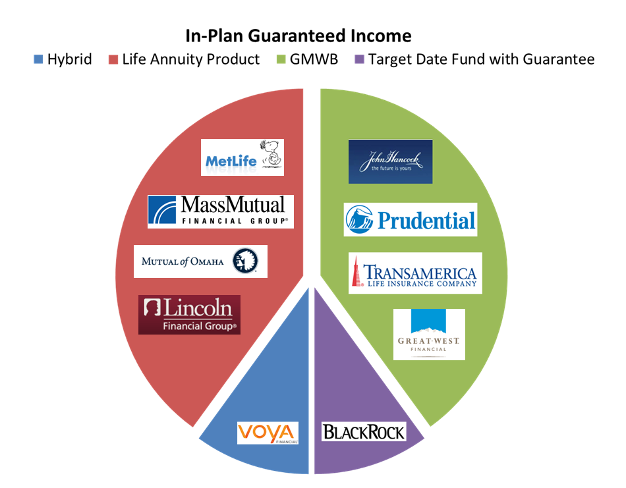
In-plan Retirement Income Products by Provider
For Intermediary use only. Not for distribution with Plan sponsors or the public. GA022814176668

Slide 20
Guaranteed Minimum Withdrawal Benefit (GMWB)
Description:
Guarantee: Contributions create benefit base, which is used to determine future income stream while providing investment liquidity at market value
  Participants may receive COLA (i.e., stated or variable credited interest rate)
  Choice of either fixed or variable guaranteed income percentage
  Guarantee may start after first contribution or at stated age
  Age minimum may apply
Benefit base: Rises with market – protected from downside
  May offer one-time step-up to market value at retirement
  Benefit base may continue to rise with market during accumulation phase
For Intermediary use only. Not for distribution with Plan sponsors or the public. GA022814176668

Slide 21
Guaranteed Minimum Withdrawal Benefit (GMWB)
GMWB Continued:
Liquidity: Market value during both accumulation and distribution phase – withdrawals reduce future income payments
Underlying investments: Held in separate account – may include asset allocation funds with either passive or actively managed funds
Portability: IRA rollover option
Fees:
  Fee range for guarantee: 0.75%-1.0%
  Investment fee range: 0.15%-1.05%
  Fees may be calculated using either benefit base or market value
Spousal provision: May reduce guaranteed income amounts by 5-20%
For Intermediary use only. Not for distribution with Plan sponsors or the public. GA022814176668

Slide 22
Deferred Fixed Annuity
Description:
Guarantee: Participant purchases units/shares, which are converted into income during retirement
Investments: Held in insurance companies general account
  Accounts credited fixed interest rate
  Do not offer market upside
Liquidity: Market value during accumulation phase, but not during the distribution phase – withdrawals reduce future income payments and may be subject to additional fees
Fees: Based on actuarial assumptions, such as age, life expectancy, plan costs and prevailing interest rates
Portability: IRA rollover option - providers may offer to hold frozen
assets so long as outside provider will record keep
Spousal Provision: May reduce guaranteed income amounts by 5-20%
For Intermediary use only. Not for distribution with Plan sponsors or the public. GA022814176668

Slide 23
Target Date Fund with Guarantee
Description:
Guarantee: Guarantee imbedded within target date fund
  Glide path replaces fixed income with annuity contracts
  May offer COLA to protect against inflation and longevity risk
Investments: Separate account holding equities, fixed income that converts to fixed deferred annuities
  Automatically invests participant in age appropriate fund
  Offers market upside potential
Fees: Combines cost for guarantee with investment expenses
Portability: IRA rollover option
Liquidity: Market value during both accumulation and distribution
phase – withdrawals reduce future income payments
Spousal Provision: May reduce guaranteed income amounts by 5-20%
For Intermediary use only. Not for distribution with Plan sponsors or the public. GA022814176668

Slide 24
Disclosure
This document is provided by John Hancock USA and John Hancock New York for informational purposes only, and while every effort is made to ensure the accuracy of its contents, it should not be relied upon as being tax, legal or financial advice. Neither John Hancock USA nor John Hancock New York, or any of its affiliates, representatives, employees, or agents provides tax, financial or legal advice.
Both John Hancock Life Insurance Company (U.S.A.) and John Hancock Life Insurance Company of New York do business under certain instances using the John Hancock Retirement Plan Services name. Group annuity contracts and recordkeeping agreements are issued by: John Hancock Life Insurance Company (U.S.A.), Boston, MA 02210 (not licensed in New York) and John Hancock Life Insurance Company of New York, Valhalla, NY 10595. Product features and availability may differ by state. John Hancock Investment Management Services, LLC, a registered investment adviser, provides investment information relating to the contracts. Plan administrative services may be provided by John Hancock Retirement Plan Services LLC or a plan consultant selected by the Plan.
NOT FDIC INSURED | MAY LOSE VALUE | NOT BANK GUARANTEED | NOT INSURED BY ANY GOVERNMENT AGENCY
© 2014 All rights reserved.
GA
For Intermediary use only. Not for distribution with Plan sponsors or the public. GA022814176668

Slide 25
Discussing Longevity Planning Options with Plan Sponsors
25

Slide 26
Challenges for Plan Sponsors/Advisors
Choosing Product/Provider
Education
Fiduciary Concerns
Benchmarking Services/Costs
Determining Participant Demand
Not Broadly Accepted
Timing of Implementation

Slide 27
Qualifying Factors
Company Profile
  Size of Company
  Locations
  Age of Employees
  Turnover Rate
  Business Plan
Retirement Plan Profile
  Plan Design
  Plan Health
  Asset Allocation
  Current Provider

Slide 28
QUESTIONS?

