Slide 1
The Changing DC Landscape:
How Regulation Is Changing the Face of the DC Plan
Dave Nadig, Moderator
President, ETF Analytics
IndexUniverse
Jimmy Veneruso, CFA, Presenter
Vice President
Callan Associates
Marcia Wagner, Presenter
Principal
The Wagner Law Group

Slide 2



Dave Nadig,
President, ETF Analytics
IndexUniverse
The Changing DC Landscape:
How Regulation Is Changing the Face of the DC Plan
Jimmy Veneruso, CFA
Vice President
Callan Associates
Marcia Wagner
Principal
The Wagner Law Group

Slide 3
General 401(k) Investment Trends
Avoid duplication within categories
Enhance fund oversight, disclosure
Simplify investment education
Smaller Menus
Most common QDIA solution
Useful transition/mapping strategy
May incorporate more complex underlying strategies
Brokerage Accounts
Target Date Funds
Improved integration/ operational support
Generally exempt from new disclosure regulations
Permits fund specialization for interested participants

Slide 4
Who’s a Fiduciary?

Slide 5
Redefining Fiduciary
Original regulation issued in 1975 used five-part test for "investment advice“:
Investment recommendation/ valuation for securities/other property
Provided on a regular basis
Delivered pursuant to a mutual understanding
Serves as a primary basis for investment decisions, and
Individualized to the particular needs of the plan
In 2011, DOL proposed removing five-part test:
Expanded definition to cover more advisors, more assets (e.g., IRAs)
Significant push back from industry
Proposed regulation withdrawn
DOL expected to re-propose fiduciary regulation in July 2013

Slide 6
Practical Implications
Non-Fiduciary Advisors
  Would need to change service model.
  Must disclose they are not providing impartial advice.
  Or they could accept fiduciary status and become subject to ERISA.
Re-proposed Rule in 2013:
  New definition to include individualized advice only.
  Will be similar in approach to DOL’s initial proposal.
  DOL is coordinating with SEC.

Slide 7
Target Date Funds

Slide 8
What Are Target Date Funds?
Popular default investment vehicle for 401(k) plans.
Typically, formed as open-end investment companies registered under the Inv. Co. Act.
Defining characteristic – “glide path” which determines the overall asset mix of the fund.
Performance issues in 2008 raised concerns, especially for near-term TDFs.
  Based on SEC analysis, the average loss for TDFs with a 2010 target date was -25%.
  Individual TDF losses as high as -41%.

Slide 9
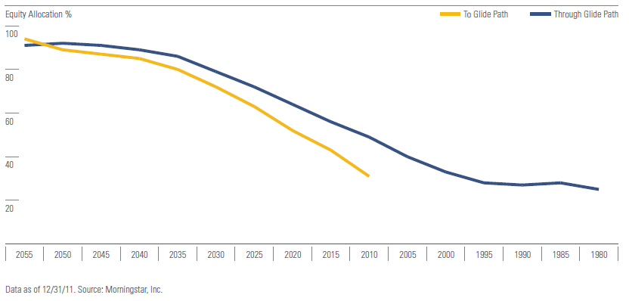
Average “To” & “Through” GlidePaths

Slide 10
TDFs Now a Mainstream Option

Slide 11
Growth of TDF & Target Risk Funds

Slide 12
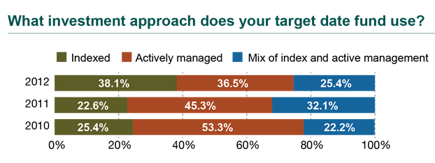
Trends In TDF & TRF Usage
Passively managed target date funds now surpass actively managed target date funds in prevalence (38.1% and 36.5%, respectively).
Nearly two-thirds (63.5%) of plans offer target date funds with some amount of passive management in the underlying fund allocation

Slide 13
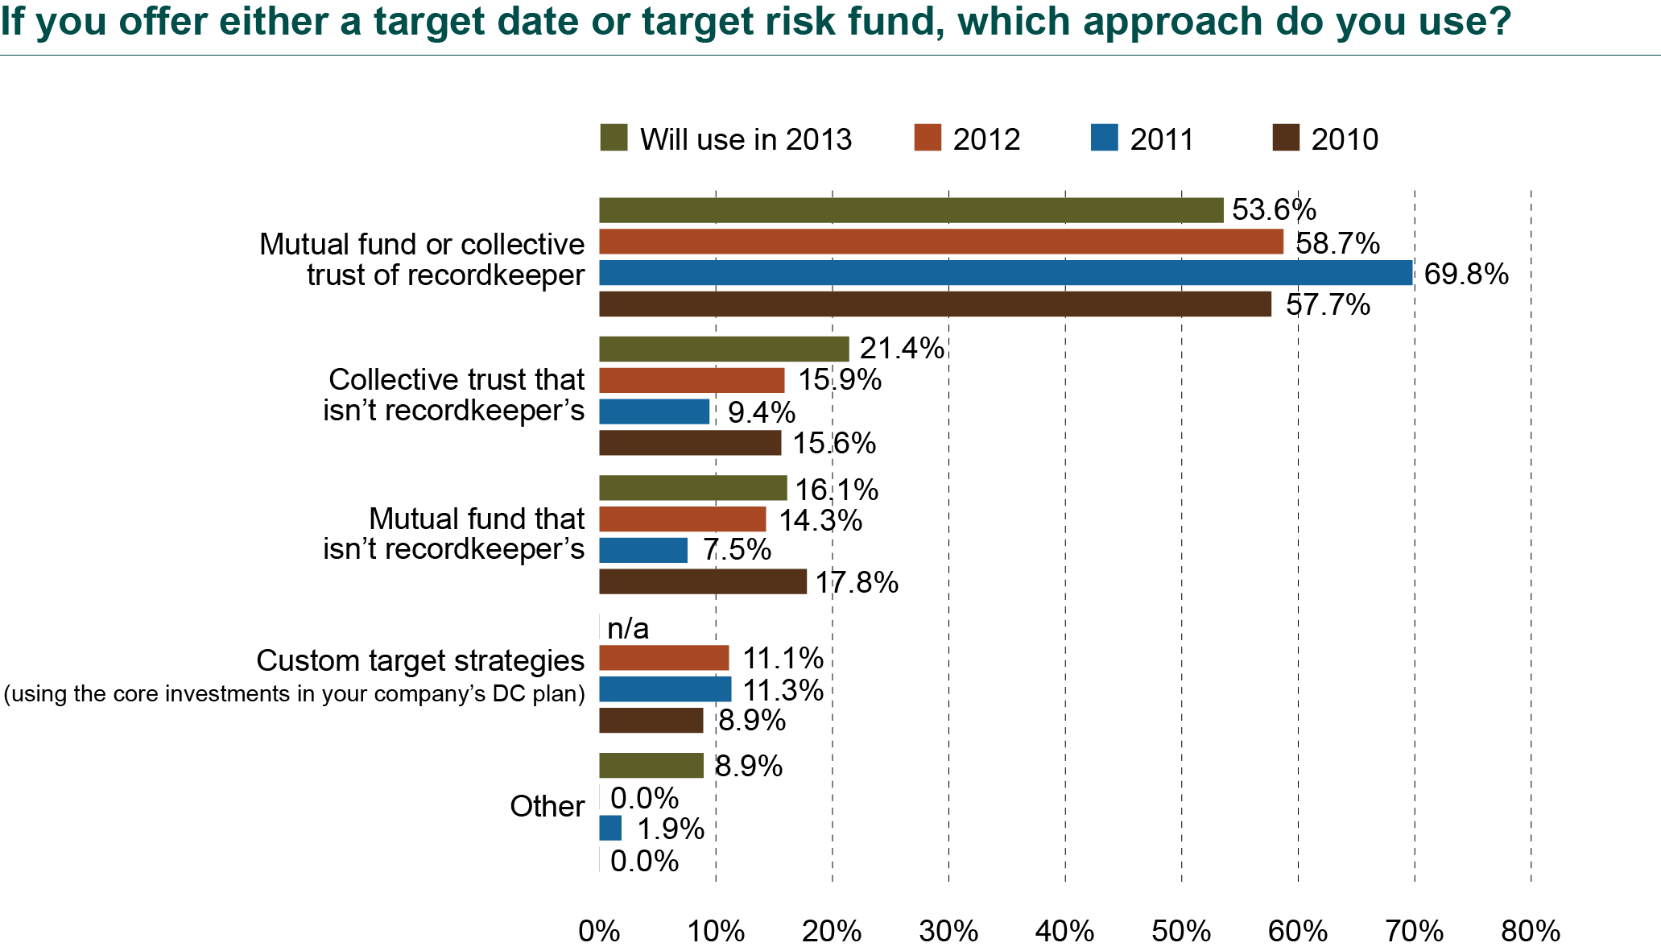
Trends In TDF & TRF Usage

Slide 14
Potential TDF Conflicts of Interest
Conflicts arise when a “fund of funds” invests in affiliated underlying funds.
Are fund managers ever subject to ERISA?
Implications of DOL guidance
  Plan sponsors are alone in their fiduciary obligation.
  Must ensure TDFs (and underlying funds) are appropriate plan investments.

Slide 15
Recent Target Date Fund Legislation
DOL and SEC at Senate Special Committee on Aging hearing on TDFs (Oct. 28, 2009).
  Investor Bulletin jointly released by DOL and SEC.
  DOL’s fiduciary checklist on TDFs is pending.
SEC proposal for TDF advertising materials.
  If name has target date, “tag line” disclosure needed.
  Advertising must include glide path information.
On Nov. 30, 2010, DOL proposes rules on TDF disclosures for participants, amending:
  QDIA reg’s issued under PPA of 2006
  Participant-level fee disclosure reg’s that were finalized on Oct. 14, 2010 and became effective in 2012.

Slide 16

TDF Proposals In Congress
Former Senator Kohl announced his intent to introduce new legislation (Dec. 2009).
  Concerns over high fees, low performance or excessive risk in many TDFs.
  Would impose ERISA fiduciary status on TDF managers when TDF used as QDIA in 401(k) plans.
“The discovery that many 2010 target date funds contain junk bonds is troubling, but not surprising. Many target date funds are composed of hidden underlying funds that can have high fees, low performance or excessive risk. With more than 90% of employers choosing off-the-shelf target date funds as their employees' standard option, there is no question that we need greater regulation and transparency of these products.”
Senator Kohl
Chair, Senate
Aging Committee

Slide 17
Target Date Fund Redesign Trends
{
Greater use of institutional/
indexed funds
Cost control
Predictability
Transparency
{
More sophisticated asset allocation strategies
Inflation protection strategies
Broader equity exposure
Revised fixed income approach
{
Investment horizon/
liability management (glide path design)
Greater life expectancies
To retirement or through retirement?
Criticism from Congress, other constituencies
{
Annuities/income guarantees
Emerging trend
Initial offerings wrapped around existing funds

Slide 18
Lifetime Income?

Slide 19
Lifetime Income
{
401(k)s Displace Pensions as Primary Retirement Plan
Traditionally, 401(k)s designed for accumulation/supplemental benefits
401(k) reporting focused on balances, not benefits
{
Balance Reporting Impacts Participant Behavior
Discourages savings due to size of target amount
May lead to overconfidence
Encourages lump sum distributions
{
DOL to Require Reporting of Projected Monthly Benefit
Questions about projection method, annuity factor, rate of return
Single number or range of possible outcomes

Slide 20
Defined Contribution & Politics
Obama Administration believes lifetime income options facilitate retirement security.
  Initiative to reduce barriers to annuitization of 401(k) plan assets.
  DOL / IRS issue joint release with requests for information on Feb 2, 2010.
  RFI addresses education, disclosure, tax rules, selection of annuity providers, 404(c) and QDIAs.
The Retirement Security Project
  Released 2 white papers on DC plan annuitization.
  Proposed use of annuities as default investment.
  Utility of default annuities limited because of different needs to retirees and difficulty in reversal

Slide 21
DC Plan Annuitization
Recent developments include two types of legislative proposals:
  Encourage annuitization with tax breaks: Lifetime Pension Annuity for You Act, Retirement Security for Life Act.
  Annual disclosure of what 401(k) plan balance would be worth as annuity: Lifetime Income Disclosure Act.

Slide 22
Tax Relief for Lifetime Income Options
Proposed Regulations & Rulings on Required Minimum Distributions:
  PLR 200951039: no surprises as to age 70 ½ interpretations.
  Proposed Reg. (Feb. 2012): longevity annuity beginning at age 80 or 85 will not violate required minimum distribution rules. Annuity premium lesser of $100,000 or 25% of account balance.
  Proposed Reg. (Feb. 2012): split distribution options consisting of annuity and lump sum approved.
  Rev. Rul. 2012-4: participants can rollover 401(k) balance to same employer DB plan and convert to annuity from DB plan.
  Rev. Rul. 2013-3: deferred annuities in 401(k) plan will not trigger IRS death benefits for surviving spouse.

Slide 23
Lifetime Income Options: Applications
Anticipate future legislation or regulation.
Most likely: DC plans must disclose monthly or yearly lifetime income that account balance can provide through annuity purchase. Possible DOL reg. in 2013
Also possible: DC plans must offer life annuities as benefit distribution option.
Be prepared to explain concept of longevity annuities.

Slide 24
Benchmarks & Fee Disclosure

Slide 25
Recent Fee Disclosure Regulations
Two fee disclosure regulations implemented in 2012
  Section 408(b)(2) disclosures to plan sponsors (Effective July 1, 2012)
  Section 404(a)(5) disclosures to participants (Effective Aug 30, 2012)
DOL considering guide/tool for 408(b)(2) disclosures
  How to read disclosures
  Potentially complex, provided through multiple documents
  Targeting May 2013 release

Slide 26
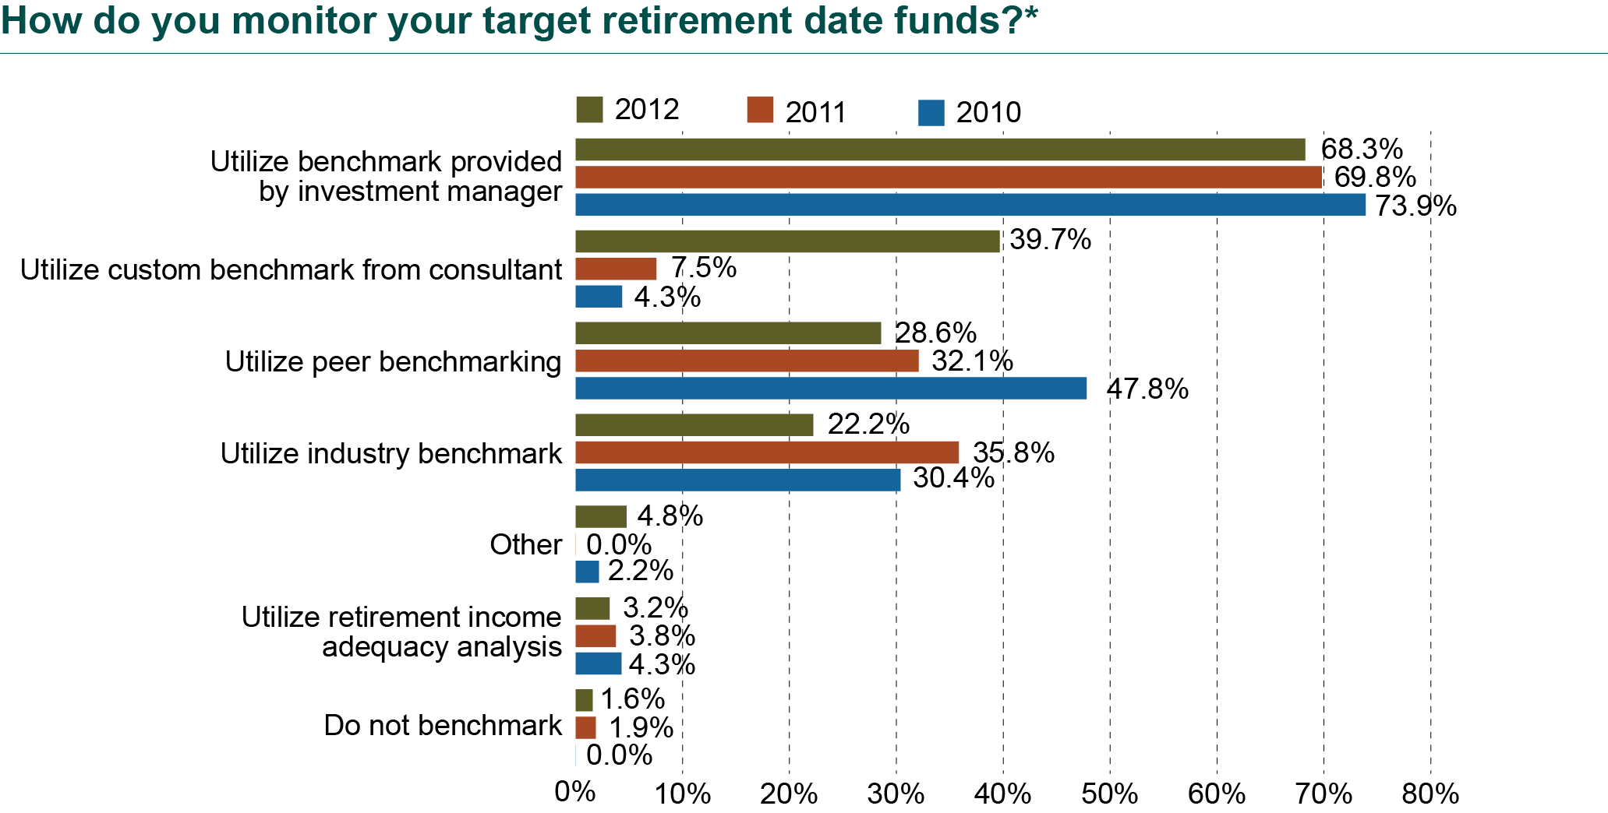
TDF Monitoring & Benchmarking
Our survey finds that a wide variety of broad-based securities market benchmarks are being used for participant disclosures, indicating little consensus on what constitutes an appropriate comparative for this purpose.

Slide 27
Thank You.
Questions?

Slide 28
The Changing DC Landscape:
How Regulation Is Changing the Face of the DC Plan
Dave Nadig, Moderator
President, ETF Analytics
IndexUniverse
Jimmy Veneruso, CFA, Presenter
Vice President
Callan Associates
Marcia Wagner, Presenter
Principal
The Wagner Law Group

