Slide 1
Delivering Value in a Target-Date Dominated World
Dick Darian
Head of DC Advisor Sales, BlackRock
Marcia Wagner
Managing Partner, The Wagner Law Group
11/13/13
Notes:
WHY NOW?
Target Date Funds were once a small component of the entire defined contribution landscape. Now, six years after the Pension Protection Act, Target Date Funds are the fastest growing segment of defined contribution and the predominate choice for QDIAs.
Plan sponsors are placing more emphasis on Target Date Funds than they did in the past. They are beginning to recognize that the complexity merits more time, attention and expertise than they initially thought.
We know that advisors want to bring the latest thinking and strategies Target Dates to their Plan Sponsor clients, so over the next (45 minutes) we’re going to provide views and insights and share research about
What’s changed over the last 12 months
Lessons learned from leading teams
Where the consulting opportunities are, and
How to apply the latest research into your consulting practice

Slide 2
By 2020 Target Date Funds Are Projected to Grow To $3.7 Trillion
  Sponsors are beginning to see the importance of the category…and the impact of their decisions
  The changing landscape means consulting opportunities for TDF experts.
  Target Date funds are the fastest growing asset class in DC plans today.
  Product choices are complex. There are over 49 fund families to evaluate.
  The Plan Sponsor’s TDF decision has a significant impact on participant outcomes.
Plan sponsors need specialists to help them
Source: Casey Quirk study 2012
Notes:
THE CURRENT LANDSCAPE
First of all, I think the most important number is really in the title. The target date funds are expected to go to 3.7 trillion dollars by 2020. Let's put that number in context for a minute. So, currently, target date fund mutual fund assets are roughly 500 billion dollars. So we're talking about going from 500 billion to nearly 4 trillion in only six and a half years.
By the end of this decade, it's likely that target date fund assets are going to be more than half of defined contribution assets. And if you put that in context of people's retirement savings, defined contribution is expected to become a bigger and bigger part of that savings. And as that happens, target date funds are going to become an even bigger and bigger part of that landscape.
As those two trends merge, what we expect to see is that the advisors and the firms that have the most success will be experts on target date funds; will be able to help their clients and help their participants ultimately save more efficiently, de-cumulate more efficiently, and really provide participants for their sponsors with better outcomes.
So we've talked about how fast target date funds are growing. We haven't talked about how complex they are. There's nearly 50 different fund families that provide target date funds, and each one of them have different underlying asset classes. Some use as many as 20 different asset classes.
Each of them have different glide paths or allocations between stocks and bonds that change periodically over time. And then ultimately each one of them are trying to accomplish something differently for the plan sponsors.
Because it's so fast growing, because it's evolving, because they're complex, it's really hard for plans to evaluate them. But what makes it complicated isn't just that there are so many variables and so many levers; it's that these choices are really driving participant outcomes.
If you look at, say, 2008, for example, the best-performing target date fund only lost about 15 percent. The worst-performing target date fund lost almost 40 percent. The target date fund that was selected by the plan that was advised by the consultant ultimately is what drove that decisions.
If you don't make the right elections here, you can ultimately give your plans, and give their participants, extremely poor outcomes. And that's not going to just impact them in the short-term; what we think will happen is they will ultimately leave the target date fund. They'll de-risk their portfolio and move in to stable value or money market fund, and then ultimately not be able to accumulate enough to have a successful retirement.
As you know, Target Date Funds are the fastest growing segment in the defined contribution market. By 2020, assets are expected to account for 50% of DC assets and grow to 3.7 trillion.
The product choices are complex. Plan sponsors have started to recognize that not all Target Date Funds are created equal, and that successfully managing a TDF required a very broad skill set. You can no longer make informed decisions by looking solely at historic investment results. Instead, an you must understand the objective and evaluate if the manager has the broad range of skills required to manage a Target Date Fund over a long period of time.
The Complexities Create Advisor Opportunities
Given their size and unique construction, TDFs can’t really be evaluated like any other fund on the plan menu. They have a different weighting and fiduciary significance and should really be considered as if they were in a distinct class of their own.
It requires specialized expertise. Consider the range of skills required to be a successful TDF manager:
Skill at managing a broad range of asset class exposures
Skill at managing asset allocation
Risk Management
Then recognize that all of these skills must be done at scale.
We think that a framework is necessary for categorizing glide paths. However, we think it makes more sense to think about them in terms of their objective.
Are they trying to preserve capital? In other words, do they have a low equity landing point, or a low equity terminal point?
Are they trying to provide stable consumption where they want kind of a middle level of equities with a balance in equity risk, in fixed income risk, in real asset risk, going from retirement onward?
Are they trying to maximize consumption, or do they have a high equity landing point?
Before we dive to far into what we believe as a firm, I want to leave our theory and walk through some of our research, key findings and advisor preferences.…….

Slide 3
Today’s Target Date Products Are Better Engineered.
Still, Some Aspects Could Be Improved.
  More choices
  More diversified asset classes
  More precise glide paths
  More conservative asset allocation
  Few or no proprietary requirements
  Overly complex
  No standard benchmarks
  Imperfect tools
  Low participant engagement
  Too many proprietary requirements
What We Heard From Advisors
  + What’s Working
  – Not Working
  Source: Qualitative interviews with 25 Retirement Specialists – January 2013
Notes:
Overall, advisors believe TDFs are better than ever before but they’re still maturing.
What’s Working:
Advisors recognize today’s funds are better engineered and offer more choices, more share classes, and more alternatives, non-traditional investments like TIPS, REITs and inflation-hedging assets and commodities.
Other improvements include fewer proprietary fund requirements, the addition of funds in 5-year increments and more precise glidepaths. As one advisor observed, “Fund companies have taken a closer look at their allocation and how it moves, analyzed their data and made tweaks to enhance their overall portfolios.”
Some advisors noted that fees for TDFs seem to have come down, and they’re seeing an increased use of index options, which also helps controls cost for their clients.
Not Working:
While TDFs have gotten better, advisors are quick to point out opportunities for improvement.
The number one issue advisors have with TDFs is there’s no fool-proof method for benchmarking and comparing TDF products. Even funds that share the same target year can vary widely in their philosophies, glidepaths and methodologies. Without a sound way to compare funds on an “apples to apples” basis, drawing conclusions for a plan sponsor can be challenging.
Another challenge advisors see is that TDFs don’t take into account that two people the same age may have very different propensities for risk. TDFs are designed with a specific target retirement year in mind, but don’t factor in a participant’s comfort level with the amount of equity exposure they may face. Also, most TDFs don’t provide a solution for a participant’s need to accumulate income and provide stability at the same time.
Advisors are also concerned about TDFs that contain mandated proprietary funds that wouldn't necessarily be included in the core lineup. Advisors believe plan sponsors have an obligation to evaluate and select the best option for their participants, and if they only have the choice of proprietary TDF, they could be open to fiduciary liability. So many of the advisors who did not want to have proprietary forced upon them were electing to move away from record keepers who did it. Those who didn't have that as such a strong decision criteria were ultimately utilizing the record keepers who did require the use of their target date funds. At least that's from the last time they did a record keeping search.
Well, now, maybe in 2013, they may need to refresh their record keeper search since some of the criteria for selecting record keepers have changed. I think if we start seeing more record keeper searches, what that will ultimately do is put downward pressure on those record keepers to ultimately move in to a more open-arm protected framework, which again, as we see more record keepers do that, it's going to be more and more advantageous to you, the advisor, who's trying to become, or is in this case, a target date fund expert.

Slide 4
A New Consulting Mindset For TDFs
Smart advisors recognize that the landscape has changed and apply new lessons into their consulting process.
GENERALIST APPROACH | DC SPECIALISTS
Traditional menu design
Menu designed around the TDF offering
Fund performance drives shortlist
Sponsor’s objective drives shortlist
Imprecise peer groups
Improved methodology
  Glidepaths Expected performance to actual
“To” vs. “Through”
Fund objective
Notes:
A NEW way of looking at target date funds
Another consideration that we'd ask you to think about is what we'll call old thinking versus new thinking. We've spent some time with some advisors in the field talking about this particular dynamic, and it's been extremely well-received. It's about transforming your mindset; rather than thinking about things the way we've always think about them, really emerging as a thought leader, and shifting your perspective for how you position defined contribution issues specifically.
So the old thinking was traditional menu design, generally designed from a style box approach. Historically, TDFs were just another fund in the core menu. Today the Target Date Fund is center stage and the menu is designed around it. We think it makes more sense to focus the design around the target date fund offering, and then have your core options largely be designed to support that target date fund offering.
We've seen historically that fund performance -- lead table, in other words -- drives your short list. We think the sponsor's objective is the best way to think about who should be on your short list, and we'll spend some time talking about that later.
- If fund performance was a key criteria for fund selection in the past, today, the sponsor’s core objectives should drive the short list.
- We all know the issues with comparing funds with different objectives. Today’s specialists look under the hood and review funds with similar strategies and intended outcomes to get at a better “apples to apples comparison.

Slide 5
DOL Considerations
For financial professional use only – not to be shown or distributed to the general public

Slide 6
Fiduciary Importance Of Using An IPS
IPS can help provide protection for plan’s fiduciaries
No rigid requirement under ERISA to establish IPS
But IPS can be protective in event of litigation or DOL audit
DOL’s 2008 Interpretive Bulletin: IPS is consistent with plan sponsor’s fiduciary obligations
IPS customarily addresses 3 areas
1) Investment objectives
2) Roles and responsibilities
3) Guidelines for investment menu
IPS should address all key aspects of menu, including TDFs

Slide 7
IPS Guidelines Necessary For Target Date Funds
TDFs have unique characteristics
“All in one” feature
Invest in broad range of underlying funds
Asset allocation changes automatically over time (glide path)
Intended as life-time investment
Plan fiduciaries must give appropriate consideration to TDF features
DOL regulations require “appropriate consideration” to be given to all relevant features
Must not evaluate and treat TDFs like other investment funds
Complication if existing IPS is silent on how to evaluate TDFs

Slide 8
DOL’s Fiduciary Tips For Selecting TDFs
DOL issued “Tips for ERISA Plan Fiduciaries” choosing TDFs (Feb. 2013)
Establish process for selecting TDFs, taking into account plan population’s characteristics
Establish process for periodic reviews of TDFs, including examination of target date investment strategy
Understand how asset allocation will change over time, including when glide path will reach landing point
Review fees and expenses, including expense ratios of underlying funds and overall TDF
Document review process

Slide 9
IPS Documentation for Target Date Funds
For financial professional use only – not to be shown or distributed to the general public

Slide 10
Scope of Fiduciary Review For TDFs
IPS should include key considerations for fiduciary review of TDFs
1) TDF’s objective
2) Glidepath
3) Asset allocation
4) Implementation strategy
IPS should also consider TDF manager’s qualifications
IPS should also address QDIA requirements
“Qualified Default Investment Alternative”
QDIA requirements generally apply if TDF is plan’s default investment

Slide 11
TDF Objective And Risk Tolerance
Review TDF manager’s strategy
Must be based on sound investment theory and reasonable capital market assumptions
Should prudently address market risk, inflation risk and longevity risk
Information available in prospectus, fund fact cards and manager’s Form ADV
Confirm level of risk is suitable on average for plan’s participants
Balance must be struck between long-term appreciation and capital preservation
Consider risk-return tradeoff and desired level of risk
Take into account specific characteristics of participant population

Slide 12
Glidepath
Glide path is critical component of TDF
Determines current target allocations and how quickly they will change
Generally becomes more conservative over time
Key elements of glide path
1) Initial equity allocation
2) Slope of glidepath
3) Equity landing point
Confirm suitability for younger and older participants

Slide 13
Asset Allocation And Asset Classes
TDF should have exposures to wide range of asset classes
Consistent with design as “all in one” investment
Typically invests in portfolio of underlying funds
Review TDF’s underlying funds
Consider investment style
Examine performance
Review fees and expenses

Slide 14
TDF Implementation Strategy
TDF’s investment style: Strategic vs. Tactical
Strategic asset allocation involves rebalancing to targets
Tactical asset allocation involves dynamic changes based on current market conditions
Underlying fund’s style: Passive vs. Active
Passive management style seeks to mirror benchmark (at relatively lower cost)
Active management style seeks to outperform benchmark
Consider fees and expenses
TDF’s implementation form:
Mutual Fund vs. Collective Trust Fund vs. Custom
Impact on costs
Implications for transparency and data availability
May affect diversity of underlying funds

Slide 15
Qualifications Of TDF Manager
Recap – key considerations for prudent fiduciary review of TDFs
1) TDF’s objective
2) Glide path
3) Asset allocation
4) Implementation strategy
IPS should include similar considerations for TDF manager’s expertise
1) Developing TDF strategies and objectives
2) Designing glide paths
3) Selecting and managing TDF’s portfolio
4) Determining style for TDF and underlying funds
IPS guidelines should also address TDF manager’s experience

Slide 16
TDF Selection Criteria For Plan’s QDIA
IPS should include QDIA guidelines
TDF must satisfy various QDIA requirements
QDIA rules include diversification requirement
TDF must be diversified so as to minimize risk of large losses
Should be designed to provide mix of equity and fixed income exposures
QDIA must also satisfy transferability requirement
Participants must be able to transfer to another option without penalty or restriction during first 90 days
No short-term redemption fee permitted for 90-day period
Plan’s QDIA should be reviewed on ongoing basis

Slide 17
IPS Process
Leverage the IPS Process
Step 1: Educate (plan sponsor)
Step 2: Revise IPS (by using Sample Addendum)
Step 3: Use IPS Worksheet (to conduct fiduciary review)
Step 4: Implement & Monitor (on ongoing basis)

Slide 18
Step 1: Educate Sponsors About IPS Process
Highlight importance of IPS guidelines for TDFs
Key characteristics of target date funds
Differences can significantly impact performance of different TDFs
IPS documentation should also serve as educational materials
See Sample Addendum and Sample Exhibit (IPS Worksheet)
Should provide general overview of TDF product design

Slide 19
Step 2: Revise IPS To Add TDF Considerations
TDF considerations should be included in plan’s existing IPS
But many IPS documents are written generically for non-TDF funds
Existing IPS may be amended through addendum
Recap: key considerations for target date funds
1) TDF’s objective
2) Glide path
3) Asset allocation
4) Implementation strategy
Other considerations for target date funds
TDF manager’s qualifications
QDIA requirements

Slide 20
Step 3: Use IPS Worksheet For TDF Evaluations
Plan fiduciaries should document TDF review process
IPS addendum is helpful, but insufficient
Need more practical and detailed documentation
IPS worksheet can assist in TDF review documentation
Note the date of review
Retain documents gathered for review
Note completion of review using IPS worksheet
IPS worksheet can help demonstrate prudent process
Attach as exhibit to IPS
Illustrative IPS worksheet included in Sample Exhibit

Slide 21
Step 3 (cont’d): Practical Guidance In IPS Worksheet
IPS worksheet can be designed to provide easy-to-follow instructions
Sample steps for evaluating TDF objective
Guidance on locating TDF’s investment strategy information
Method for assessing risk tolerance of participants
Conservative TDF more appropriate for participants with lower risk tolerance
Sample steps for evaluating TDF glide path
Focus on key elements: (1) initial equity allocation, (2) slope and (3) equity landing point
Glide path must be appropriate for both younger and older participants

Slide 22
Step 3 (cont’d): More Sample Steps For IPS Worksheet
Sample steps for evaluating TDF’s asset allocation
Checklist for confirming coverage of all major asset classes
Guidance on what to focus on when evaluating underlying funds
Sample steps for reviewing TDF implementation strategy
Checklist leads user through review of investment styles and implementation form
TDF: Strategic vs. Tactical
Underlying Funds: Passive vs. Active
Form: Mutual Fund vs. Collective Trust Fund vs. Custom
Other sample steps
Direction on evaluating qualifications of TDF manager
Selection criteria for QDIA

Slide 23
Step 4: Implementing The IPS and Monitoring
TDF guidelines should supplement existing guidelines in IPS
Sample Addendum guidelines are not designed as stand-alone procedures
Existing guidelines for regular funds should also apply to TDFs
Fees and expenses
Performance reviews
Enhanced monitoring for underperforming funds (watch list)
TDF review considerations are additions to regular monitoring process

Slide 24
Conducting Regular Reviews Of The IPS
IPS is governing instrument for plan
Plan fiduciaries should review from time to time (e.g., annually, every other year)
Regular reviews will not necessarily require frequent revisions to IPS
IPS provisions are binding on plan fiduciaries
IPS guidelines should be fair and workable
Should not lock plan fiduciaries into unwanted actions

Slide 25
Delivering In-Demand IPS Expertise
Concluding thoughts for advisors
Plan sponsors need clear guidance on role of TDFs
Also need clear IPS guidelines for TDFs
TDF guidelines and IPS worksheet may be added to existing IPS
Providing sample documentation alone to plan clients is not enough
Educate plan clients about IPS process
Implement procedures included in IPS documentation
Help plan sponsors choose the right TDFs for participants

Slide 26
How BlackRock Can Help
For financial professional use only – not to be shown or distributed to the general public
Notes:
So how can we help? And, you know we very much want to help. Defined Contribution is a strategic initiative of the firm. We're staffed with over 90 people who are experts of various parts of the defined contribution business, whether it's your DCC, who you meet with in the field; some of our marketing staff, whom we've had positive experiences with; or an investment strategist; the operations and onboarding personnel. You know, we have a wide variety of skill sets available to help you
At BlackRock, we’re committed to providing advisors with the tools and support you need.
We have developed a series of sponsor-ready and brand neutral resources you can use for every stage of your consulting engagement.
Let’s take a look at what’s available …

Slide 27
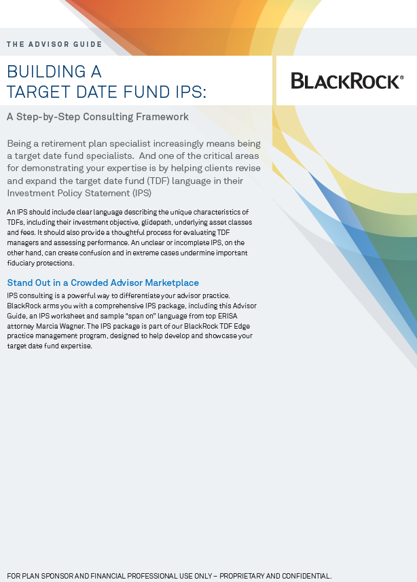
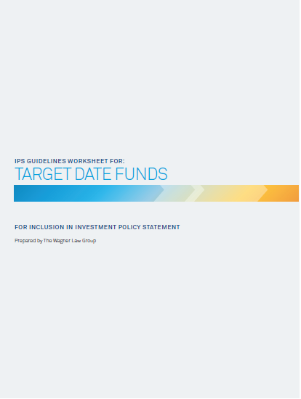
BlackRock’s IPS Package Can Help You Build The Optimal IPS
The Advisor Guide
Includes a step-by-step consulting framework to help you develop a repeatable process for educating plan sponsors
Instructions to help guide a plan’s prudent review process
Provides practical and detailed guidance on TDFs
IPS Worksheet and Sample Addendum
Designed to serve as “snap on” amendment to IPS
Includes high-level guidance for plan fiduciaries
Sample screen shots are for illustrative purposes only.

Slide 28
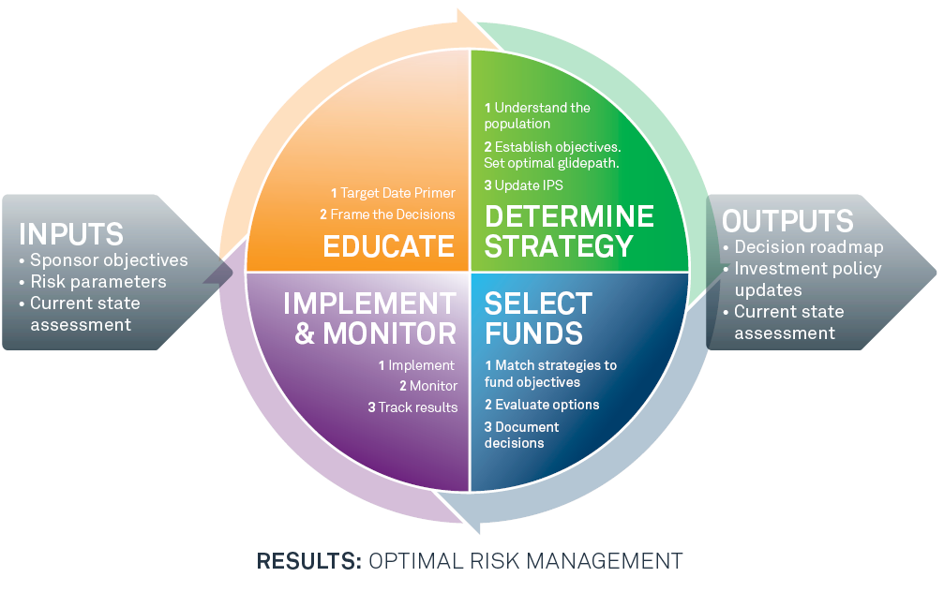
Become A Target Date Fund Specialist And Grow Your Practice
  Establish a specialized consulting framework specific to TDFs
Notes:
Advisors can leverage their Target Date expertise to grow their practice
So let's talk a little bit about consulting opportunities and how you can differentiate yourself. So, as we've talked about earlier, it's important to think about practice management and becoming a target date fund specialist. If the industry is 500 billion today and going to grow to 4 trillion, it's certainly important that your expertise grows with those assets.
So we think that the right framework for approaching plans around target date funds is, number one, educate. Help them understand what a target date fund does, what it's supposed to do, what it can do for their participants, and then understand the role that objective plays. Then determine what type of objective is appropriate for the plan by looking at the risk parameters of the plan, the participant demographics, the preferences of the investment committee, what type of firm they strive to be; and then determine what the objective is.
Once you've determined what the objective is, you select funds that match that objective, and then ultimately select the fund that best matches the objective and best solves the needs of the plan sponsor, and then continually evaluate the product, continually monitor the product. You're not off-the-hook once you've made a selection. You need to continually make sure that the fund is continually a best-in-class service.
Here’s how:
Show clients and prospects your consulting process for TDFs to strengthen your position as an expert.
BlackRock has developed a consulting framework for specialists to incorporate into their sponsor conversations
We have also developed sponsor-ready decision tools for each step of the process.

Slide 29
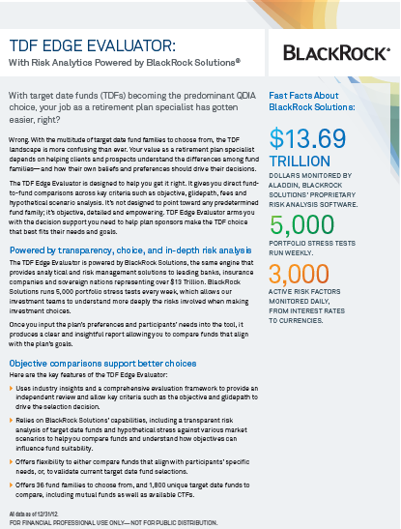
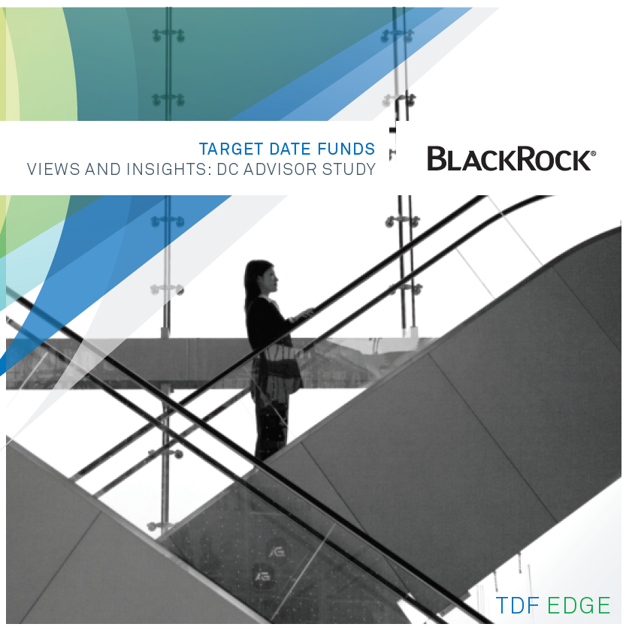
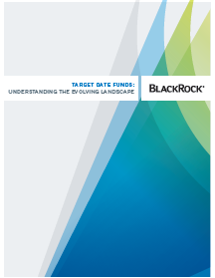

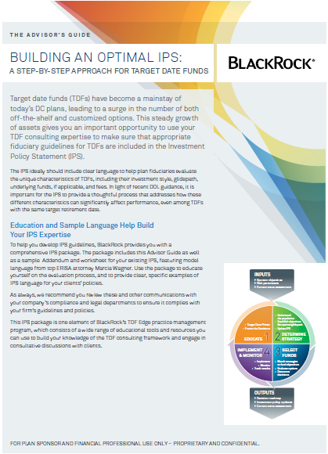


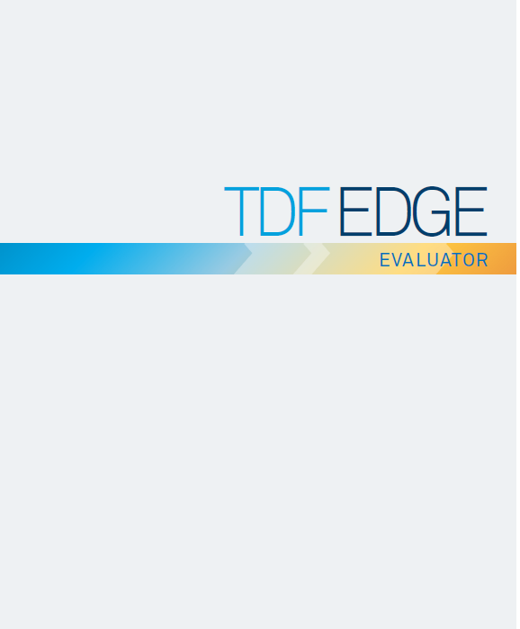
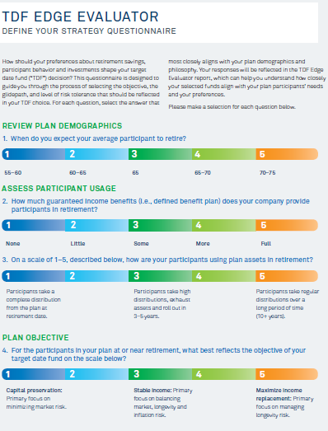
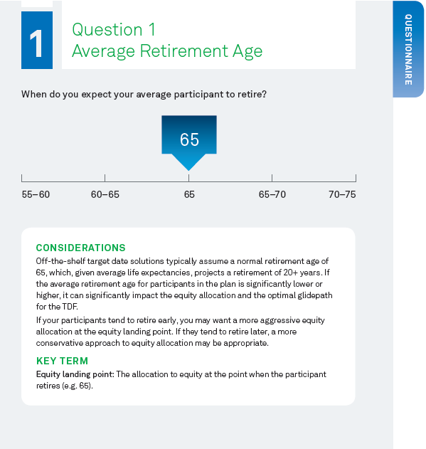

Consulting Resources For Every Stage Of Your Client Engagement
Plan Sponsor Resources | Give Your Practice a TDF Edge! Advisor Resources
TDF EDUCATION SERIES
Plan Sponsor Meeting Slides The importance of working with a TDF specialist The TDF consulting process Education on various asset allocation options Assessing the anatomy of a TDF A primer on glidepaths | Advisor Views and Insights Study Advisor Education Articles Understanding the evolving landscape Using your expertise to win and retain clients
OBJECTIVE SETTING TOOLS
The Essential Guide to TDFs Plan Sponsor IPS language for TDFs | The Advisor Guide to Building Optimal IPS The Advisor Guide to Target Date Funds
TDF SELECTION
TDF Edge Evaluator | TDF Edge Evaluator and Overview
IMPLEMENTATION & MONITORING
Re-enrollment kit* Communication best practices series* | TDF Implementation advisor tip sheet* Ask the Expert Series* Questions to ask TDF managers*
Education Materials
New IPS Advisor Guide and Worksheet
TDF Evaluator Resources
*Coming 2014
http://blackrock.com/tdfedge
Notes:
BlackRock’s TDF Edge program provides advisors with sponsor-ready tools and resources to help you consult with clients through every stage of the engagement.
Our TDF education series includes pre-formatted slides you can use to educate sponsors about the key design decisions and why they need to work with our expert.
Goals setting tools to use in sponsor meetings to establish the objectives and TDF selection criteria.
Model IPS language specific to the TD analysis category.
And we recently introduced a new TD analyzer tool called TDF Edge Evaluator Tool. The Evaluator is a tool developed to assist plan sponsors and their advisors objectively compare target date funds by focusing on a number of categories that help to identify the fund series that may best fit participants’ needs and plan sponsor preferences. The Evaluator generates a detailed report (the “TDF Edge Evaluator Report”) that compares the selected target date fund series using the following categories: (i) TDF Manager Organization, (ii) Investment Objective, (iii) Glidepath, (iv) Asset Allocation, (v) Implementation, (vi) Expense Ratio, and (vii) Performance

Slide 30
Your BlackRock DC Partners
WA
NH
MT
ND
VT
ME
OR
MN
MA
ID
SD
WI
NY
RI
WY
MI
CT
NV
NE
IA
OH
PA
NYC / LI
CA
UT
CO
IL
IN
NJ
KS
MO
KY
WV
VA
DE
NC
MD
AZ
NM
OK
TN
DC
AR
GA
SC
MS
AL
AK
TX
LA
FL
HI
Dick Darian | National Sales Manager DC Advisor–Sold |  | 551-697-1165 | richard.darian@blackrock.com
DC Advisor Consultant | Territory |  | Phone number | Email address | Internal DC Advisor Consultant | Phone number | Email address
Chris Mango |  | Northeast & NJ | 617-960-6442 | christian.mango@blackrock.com | Michael Murray | 609-282-4853 | michael.murray@blackrock.com
Mitch Horan |  | NYC Metro | 201-803-1718 | mitchell.horan@blackrock.com | Joe Rosenthal | 609-282-4728 | joe.rosenthal@blackrock.com
David Quester |  | Mid-Atlantic | 610-930-6616 | david.quester@blackrock.com | Kevin Zeller | 609-282-4820 | kevin.zeller@blackrock.com
Pete Falkowski |  | Mid-America | 248-701-4566 | peter.falkowski@blackrock.com | Val Ferrara | 212-810-5267 | val.ferrara@blackrock.com
Eben Wheeler |  | Southeast | 704-292-5437 | eben.wheeler@blackrock.com | Allison Rumpp | 609-282-4854 | allison.rumpp@blackrock.com
Jeff Stevens |  | Midwest | 763-232-6790 | jeff.stevens@blackrock.com | Brett Burgau | 609-282-4883 | brett.burgau@blackrock.com
Robert J. Cruz |  | South Central | 469-585-6375 | robert.cruz@blackrock.com | Chris Han | 609-282-4770 | christopher.han@blackrock.com
Peter Campagna |  | Pacific Northwest | 415-906-9203 | peter.campagna@blackrock.com | Darlene Giz | 609-282-4776 | darlene.giz@blackrock.com
Art Villar |  | Southwest | 562-354-6077 | art.villar@blackrock.com | Tony Taffuri | 609-282-4884 | anthony.taffuri@blackrock.com
30

Slide 31
Important Notes
Investing involves risk, including possible loss of principal. Asset allocation models and diversification do not promise any level of performance or guarantee against loss of principal.
Investment in the funds is subject to the risks of the underlying funds. The principal value of the funds is not guaranteed at any time, including at and after the target date.
This publication is not an offer to sell, nor an invitation to apply for any particular product or service.
(c) 2013 BlackRock, Inc. BLACKROCK is a registered trademark of BlackRock, Inc. All other trademarks are those of their respective owners.
DC-0617
A0108856.PPTX
For financial professional use only – not to be shown or distributed to the general public

