Slide 1


Avoiding a Fiduciary Trap in your Call Center
Marcia S. Wagner Louis S. Harvey
February 25, 2016

Slide 2
Agenda
    Introduction
    Regulatory Landscape
    DOL’s Fiduciary Rule
    Risks For Contact Centers
    Next Steps
    Questions

Slide 3
Regulatory Landscape
Contact Centers
  Plan RK platforms offer participant contact centers, and many financial institutions offer IRA service centers
  Potential for “functional” fiduciary status
  Any accidental fiduciary advice may trigger a prohibited transaction (PT)
Heightened Scrutiny for Rollovers
  If platform offers proprietary products or services, contact center’s mishandling of rollovers may trigger a PT
  Young v. Principal Financial Group (S.D. Iowa 2008)

Slide 4
DOL’s Existing Fiduciary Rule
Fiduciary Definition of “Investment Advice”
  Providers of “investment advice” for compensation are automatically deemed to be plan fiduciaries
  Existing definition includes “regular basis” and “primary basis” conditions
Safe Harbor for “Investment Education”
  Providers may safely provide non-fiduciary education:
  (1) Plan Info, (2) General Financial/Investment Info, (3) Asset Allocation Models, and (4) Interactive Materials
  Permissible to reference plan’s specific investments

Slide 5
Current Regulatory Environment
Services Offered by Contact Centers
  Plan contact centers may provide investment-related and distribution/rollover assistance to participants
  IRA service centers may provide rollover/consolidation and investment assistance to IRA owners
ERISA Implications
  Generally, contact centers assume they can avoid fiduciary status under DOL’s existing fiduciary definition
  Many contact centers have not implemented formal safeguards or adopt policies and procedures

Slide 6
Overview of DOL Fiduciary Proposal
Broadening of Fiduciary Definition
  DOL proposal would broaden scope of providers who would be deemed Plan/IRA fiduciaries
  One-time investment advice or recommending a distribution (with or w/o rollover) would be fiduciary advice
Potential Risk for Contact Centers
  Discussions with Plan/IRA clients may inadvertently be deemed to be fiduciary advice
  Fiduciary advice triggers fiduciary standard, PT rules and potential liability for contact center rep and platform

Slide 7
Carve-Out from Fiduciary Advice Definition
Investment Education (Proposed)
  Carve-out is similar to existing safe harbor:
  (1) Plan/IRA Info, (2) General Financial/Investment Info, (3) Asset Allocation Models, and (4) Interactive Materials
Observations and Special Considerations
  Carve-out applies to plan sponsors, participants and IRAs
  References to specific investment products are prohibited
  Commentators have asked DOL to revise carve-out to permit plan call centers to discuss plan’s investments

Slide 8
Impact of DOL Rule on Contact Centers
Avoiding Fiduciary Status Under New DOL Rule
  Must comply with carve-out for Investment Education
  Must ensure distribution/rollover assistance is limited to discussing availability (but not advisability)
Platforms Offering Advisory Services/Products
  Recommendations that promote platform’s own advisory services/products would be deemed fiduciary advice
  Best Interest Contract (BIC) Exemption may be required if rollover advice (or other fiduciary advice) is conflicted
  As proposed, BIC Exemption would require:
  (1) written contract, (2) comprehensive disclosures, and (3) compliance policies and procedures

Slide 9
Risks for Contact Centers
Fiduciary Risk
  Restore losses… a fiduciary may be held responsible when losses occur
  Liability for imprudent actions… the standard for a fiduciary is prudence
  Prohibited transaction violation… conflicts of interests are prohibited
Service Risk
  Client response to degraded service level… must find alternatives that avoid triggering a negative client response
  Lower client satisfaction… for clients who are unable/unwilling to make their own decisions
  Reduced client retention… retention suffers if competitors are more accommodating
  Reputational risk… unpleasant incidents easily escalate and injure ability to win business

Slide 10
Fiduciary Activities
The following are considered fiduciary acts:
  A written or verbal opinion or recommendation:
  - To buy, sell or hold a security
  - To take or not to take a distribution from a plan or IRA (rollover)
  - For how to invest distributions from a plan or IRA
  - Of a manager for plan or IRA assets
  - Of a manager for distributions from a plan or IRA
  - Or appraisal of the value of investments in a transaction
  - Of an advisor to help with any of the above

Slide 11
Non-Fiduciary Activities
The following are considered education, not advice
  Information about plan or IRA, but no recommendations or reference to the appropriateness of a choice:
  - Investment
  - Investment manager
  - Valuation
  - Distribution options
  Benefits of plan or IRA participation including impact, advantages, disadvantages and risks of various actions/features
  Describe investment objectives and philosophies, risk and return characteristics, historical return of investment alternatives

Slide 12
To Answer or Not To Answer
Your contact center can choose to…
  Answer: Requires use of Best Interest Contract Exemption (BICE)
  Not answer: Degrade service… Potentially fail to meet expectation
Typical high value questions
  “I am about to retire, what should I do with my 401(k)?”
  “My account just lost $100,000 should I get out of the target date fund?”
  “I have money in my old employer’s 401(k). What should I do with it?”
  “My plan offers a managed account, should I switch to that?”
  “Where do you suggest I go to get the answers to my questions?”
How will your contact center deal with these questions?

Slide 13
Risk Mitigation
Practices and Procedures
  Written procedures that support the policies that the firm has adopted
  Changes to service standards where applicable
Re-Training
  Amend training curriculum
  Develop training plan
  Deliver training
Monitoring:
  Control to establish that policies are being used consistently
  Identify areas where changes/improvements are necessary
  Identify individuals that succeed/fail to comply

Slide 14
Next Steps
Outlook for DOL Fiduciary Rule
  Final rule may be published as early as April 2016
  Enforcement after 8-month grace period (Dec. 2016?)
Suggested Best Practices for Call Centers
  Stay clear of providing fiduciary advice (as re-defined)
  Provide training on DOL Fiduciary Rule for contact center reps
  Assess if contact center will refer callers to sales reps or make sales pitches, and coordinate with BIC Exemption
  Adopt compliance and supervisory policies for contact center
        Model policies (WLG/DALBAR) are in the works
        Please email us to learn more about how we can help

Slide 15
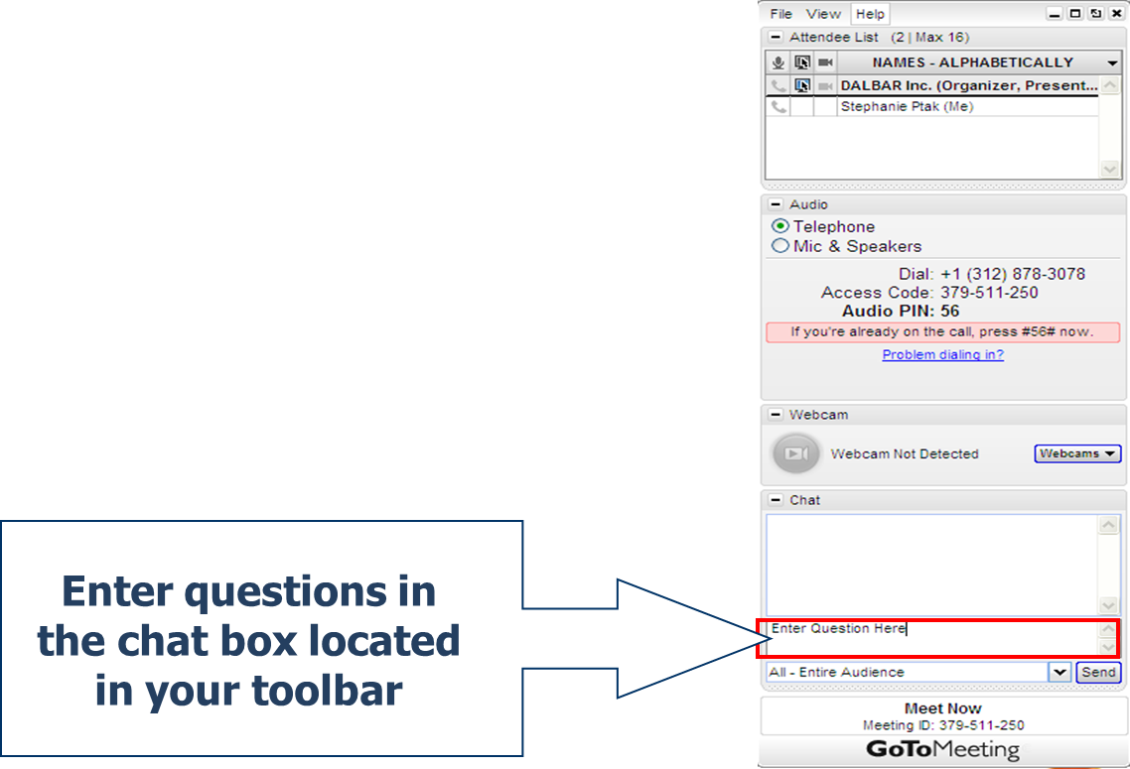
Questions?

Slide 16
Contact Information
The Wagner Law Group
  Marcia Wagner
  Managing Director
  marcia@wagnerlawgroup.com
  Important Information
  These materials are intended for general informational purposes only, and do not constitute legal, tax or investment advice on the part of The Wagner Group and its affiliates.
DALBAR
  Kathleen Whalen
  Managing Director
  kwhalen@dalbar.com

Slide 17
Thank You!

