Slide 1
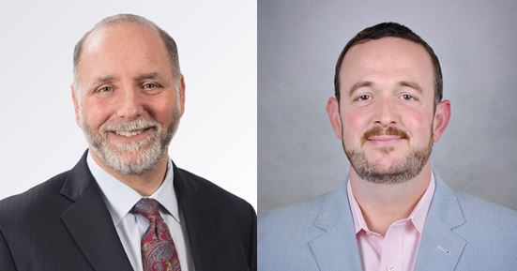
COVID-19 and Director and Officer Liability: Defense, Insurance Coverage and the Role of the Broker Presented by:
Stephen Rosenberg,
The Wagner Law Group
srosenberg@wagnerlawgroup.com
Machua Millett,
Marsh, USA
machua.millett@marsh.com

Slide 3
Why a Market Collapse Is Like the Tide Going Out
One of the lessons we learned after 2008 as ERISA litigators is a variation of Warren Buffett’s idea
Namely – that what employees, plan participants and others ignored while the market kept going up, they will sue over when the market collapses
Or jobs disappear, or a significant downturn in other economic indicators

Slide 4
Our Goals Today
What do the types of claims against company directors and officers that arise out of a substantial market downturn look like?
What does insurance coverage for those claims look like?
How can you use a claim advocate to maximize your coverage and protection against those claims?

Slide 5
Why Sue the Directors and the Officers?
Target directors and officers
Trigger insurance coverage for directors and officers
Trigger indemnity obligations of company
Target individuals with presumed deep pockets
Trigger personal financial risks and personal reputational risks
Potentially avoid some barriers to recovery from the company itself

Slide 6
Lessons from ‘08
We will discuss four claim scenarios from the post -08 period that demonstrate the risks and nature of these claims
Defended them all, settled some, tried one, won another on appeal
Names have been changed to protect the innocent
Long tail, highlighting the need for vigilance regarding insurance coverage, especially where defense costs deplete coverage.
Last of the post ‘08 claims ended when an appellate ruling was issued eight years later

Slide 7
First Scenario – Breach of Fiduciary Duty Class Action
Class action against directors and officers, including president, CEO and private equity investors
Cause of action – Breach of fiduciary duty under ERISA
Fact pattern: employee elective deferrals to 401(k) plan for preceding month never deposited into participant accounts

Slide 8
First Scenario – Breach of Fiduciary Duty Class Action(Cont.)
Why not?
Company floating it; deferrals intermingled with general cash account; intention to deposit it as late as possible
However, lender swept the account and seized all cash holdings before those funds were deposited

Slide 9
First Scenario – Breach of Fiduciary Duty Class Action(Cont.)
Defense strategy:
Funds were not yet required to be deposited at time seized, so no breach of fiduciary duties under ERISA
The named defendant officers were not the decision makers, so were not fiduciaries
The actual decision makers were lower level executives without deep pockets (and who were not named for that reason)

Slide 10
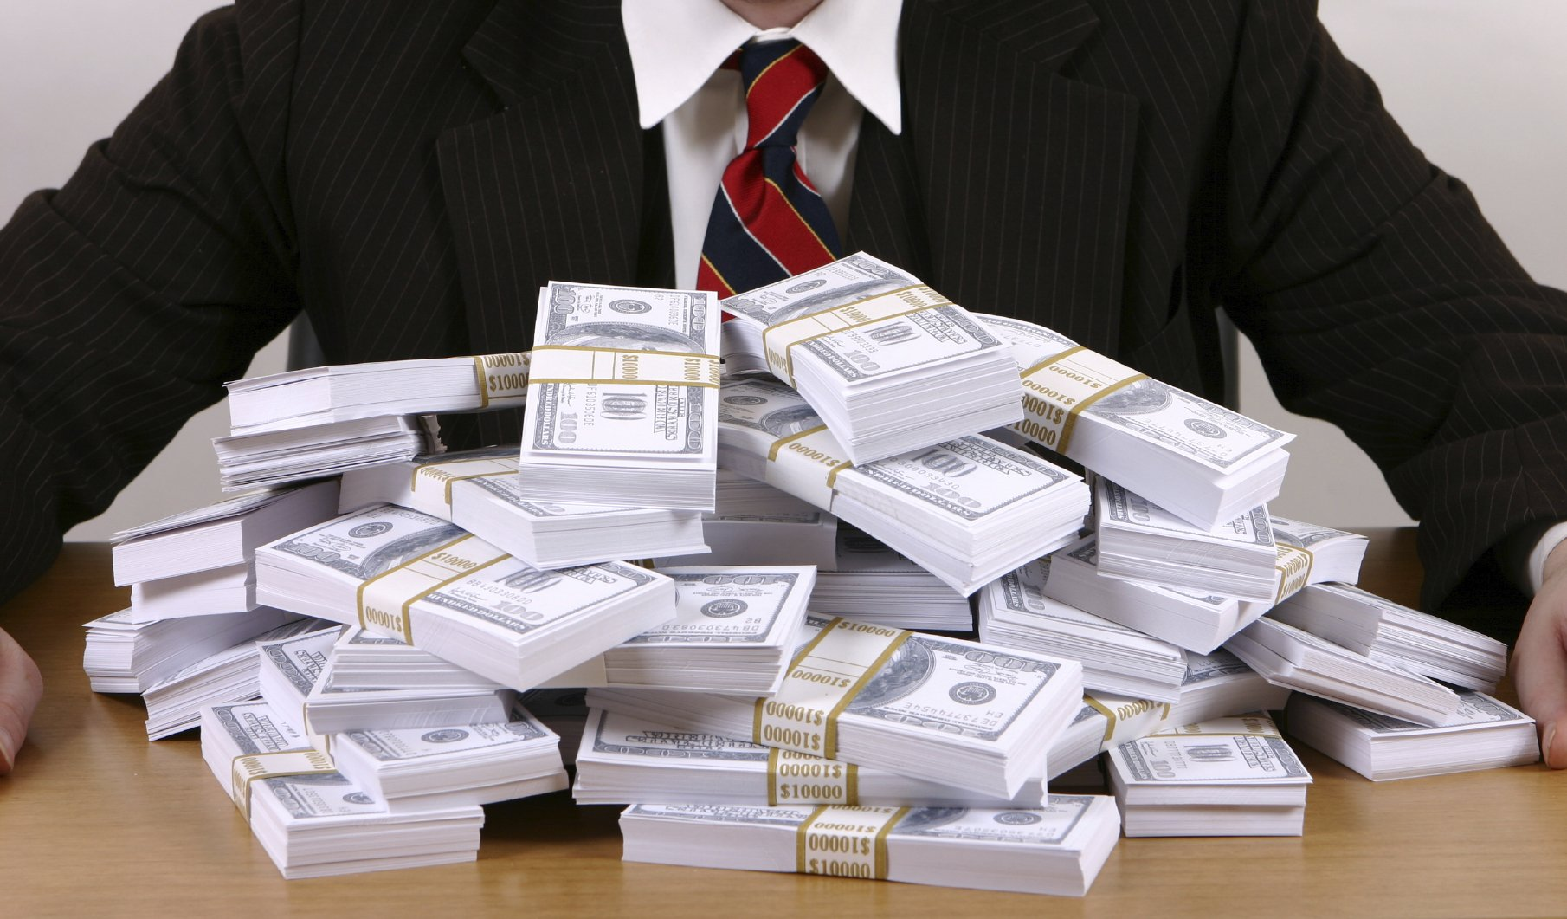
So what happened? Settlement, paid by directors and officers insurer, after court ruled the deep pocket defendants were not fiduciaries, leaving only insurance money as target

Slide 11
First Scenario – Breach of Fiduciary Duty Class Action – Insurance and Claims Advocacy Issues
Insurance Issues
Policy triggers and priority: D&O insurance; fiduciary liability; private equity GPL.
Insured Person definitions.
Exclusions at inception and after court rulings.
Claims Advocacy Issues
Coordinate response of various insurers.
Allocation: maximize defense costs coverage.
Position insurers to fund settlement.

Slide 12
Second Scenario- Personal Liability Theory Against Officer
Cash intensive business operations
Trial testimony – post downturn, cash flow from customer base and from fundraising substantially reduced
After market collapse, clients cancel contracts, seek returns of millions in deposits and other amounts
Testimony of officer at trial: “like a bank run”
Company in bankruptcy
One client elects to avoid bankruptcy claim by suing private equity lead investor who had stepped in as chairman and CEO
Alleges he had committed tort of conversion when he used available funds for other purposes (all legitimate) rather than refund $2 million to that client

Slide 13
Second Scenario- Personal Liability Theory Against Officer(Cont.)
A long tail case
Six years of discovery and motion practice
Substantial defense costs
Multiple claims
Only some covered by insurance
Evidence eventually comes into the record, late in case, that provokes a reservation of right not to indemnify, and to only pay defense costs
Reservation of right to recoup defense costs

Slide 14
Insurer unwilling to fund a settlement
Tried to a jury
Plaintiff’s counsel: jury won’t like the defendant in this economy
Company officer lost

Slide 15
But surprise! Justice prevails!
With the insurer still paying the defense costs, an appeals court overturned. Officer made new law, and prevailed.

Slide 16
Second Scenario – Personal Liability Theory Against Officer – Insurance and Claims Advocacy Issues
Insurance Issues
Impact of company bankruptcy – change in control; indemnification; priority of payments.
Conduct exclusion.
Definition of Loss.
Claims Advocacy Issues
Navigate bankruptcy process and ramifications.
Position insurer to follow defense strategy: fight or settle…

Slide 17
Third Scenario – Employer Stock Drop
Class action against officers
Effectively, a stand in for a securities claim under the securities laws
Nature of claim: public company should not have included its own stock as an investment option in a defined contribution plan
Or should have discontinued doing so

Slide 18
Third Scenario – Employer Stock Drop(Cont.)
Theory of liability: the officers should have known, or did in fact know of, serious risk to the stock price and/or that the stock price was inflated, but allowed employees to continue purchasing company stock in the retirement plan

Slide 19
Third Scenario – Employer Stock Drop(Cont.)
Sounds like a typical securities law claim
But its better (at least until the Supreme Court throws up a major roadblock in 2014, forcing litigants back to the securities laws instead)
Why better?
Brought under ERISA against officers as plan fiduciaries
All that is necessary is to prove the elements of a breach of fiduciary duty claim
Not confronted by jurisprudence limiting securities actions

Slide 20
Third Scenario – Employer Stock Drop(Cont.)
How is officer liable?
If actively involved in the selection and continued provision of employer stock as an investment option, is arguably acting as a fiduciary
And can therefore be liable for the losses from the stock purchases if offering employer stock as an investment option was imprudent

Slide 21
Third Scenario – Employer Stock Drop(Cont.)
Why valuable to the plaintiffs and the class?
Given that the officer won’t have the assets to cover any such liability
Under ERISA, breach of fiduciary duty is a personal liability of the fiduciary
The officer is a pass through
Either the liability is indemnified by the company
Or is covered by the insurer

Slide 22
Third Scenario – Employer Stock Drop – Insurance and Claims Advocacy Issues
Insurance Issues
Policy triggers and priority: D&O insurance vs. fiduciary liability.
Insured Person definitions.
Exclusions at inception and after court rulings.
Claims Advocacy Issues
Coordinate response of various insurers.
Manage limited resources -- ensure personal asset protection.

Slide 23
Fourth Scenario – Death by a Thousand Cases
Post – 08 collapse, company shuts down a number of operations throughout the country
Benefits not paid
Wages not paid
Significant operations in multiple states shut down
Customer and vendor disputes in multiple states
First significant claims filed in Massachusetts arising from 800 employee operation closed
Cases follow in multiple jurisdictions throughout the country

Slide 24
Fourth Scenario: Organizing a defense and settlement strategy
Lawsuits vary in scale, from class actions to small customer disputes
Many, but not all, trigger insurance coverage
Although often only because one out of many claims in a given suit triggers a defense duty
The legal claims are not all that complicated or distinct, from one jurisdiction to the next
Many involve variations of one of a few legal theories: state breach of contract, state wage act, state tort law including misrepresentation

Slide 25
Fourth Scenario – Organizing a defense and settlement strategy
What is complicated, however, is the company’s business practices, business model, and acquisition history
Some of the claims relate to acquisitions that weren’t finished yet and others that were, but were not well documented
Many key decision makers and fact witnesses, including senior executives, who are important to the defense of the claims are no longer with the company (some become hostile during the course of the many cases)

Slide 26
Fourth Scenario – Organizing a defense and settlement strategy
Thus, the key is to have the lawyers who handled the first claim, in Massachusetts, and thereby developed deep expertise on the relevant subjects and with regard to the witnesses, handle the cases throughout the country
But insurer preferred to use its panel counsel in each state, rather than incur the costs of out of state counsel and of need for local counsel
We eventually convinced the insurer to allow the original defense counsel to handle the cases throughout the country

Slide 27
Fourth Scenario – Organizing a defense and settlement strategy – Insurance and Claims Advocacy Issues
Insurance Issues
Policy triggers and priority – duty to defend/indemnify.
Consent to defense counsel and rates.
Allocation between policies and between covered and uncovered claims.
Claims Advocacy Issues
Coordinate response of various insurers.
Reduce delta between covered and uncovered defense costs.

Slide 28
Conclusion
Any significant economic downturn inevitably increases the litigations risks for directors and officers
But a combination of intelligent defense strategy and maximization of insurance benefits can minimize that exposure

Slide 29
COVID-19 and Director and Officer Liability: Defense, Insurance Coverage and the Role of the Broker Presented by:
Stephen Rosenberg,
The Wagner Law Group
srosenberg@wagnerlawgroup.com
Machua Millett,
Marsh, USA
machua.millett@marsh.com

